Slide 1
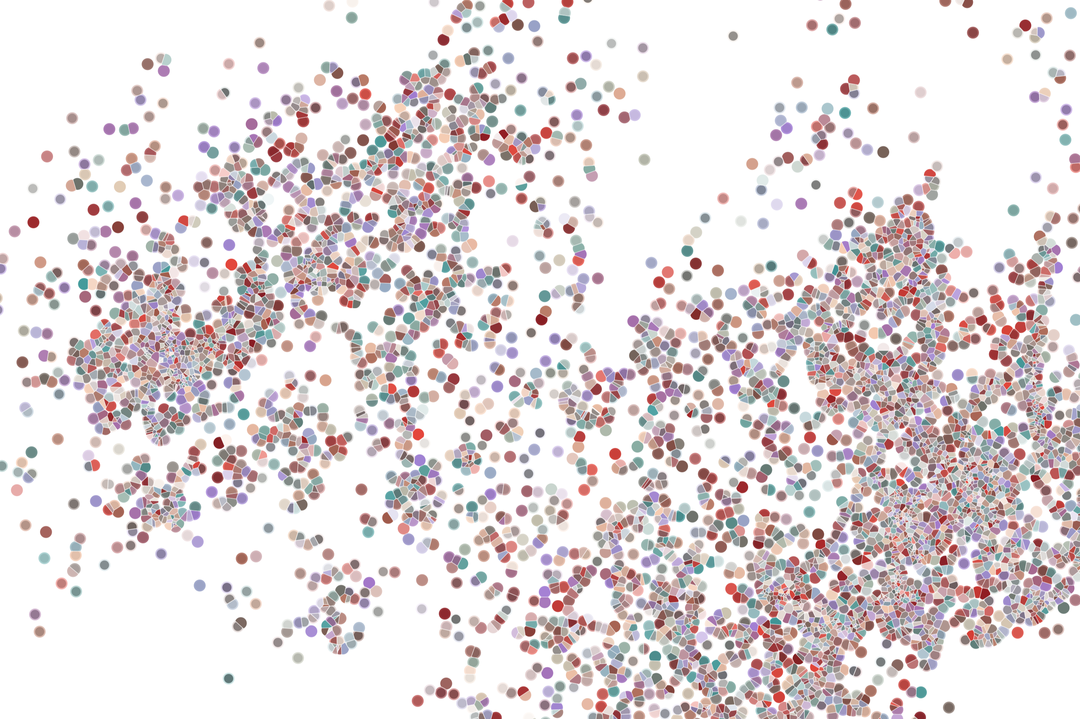
R Classes
Physalia course 2022
Instructor: Jacques Serizay
Notes:
Hello everybody and thank you for attending my presentation. I am going to talk about the project I recently started working on in the Spassky and Koszul labs, both located in Paris. This project focuses on the unusual cooption of the mitotic machinery to drive, not cell division but cell differentiation.

Slide 2
Some vocabulary
Everything in R is an object.

Slide 3
Some vocabulary
Everything in R is an object.
Class = blueprint, i.e. description of a data structure (attributes, methods)
Object = instance of a class

Slide 4
Some vocabulary
Everything in R is an object.
Class = blueprint, i.e. description of a data structure (attributes, methods)
Object = instance of a class
We can think of classes like a sketch (prototype) of a house. It contains all the details about the floors, doors, windows…
House is the object. As, many houses can be made from a description, we can create many objects from a class.

Slide 5
Examples
> x <- c(0.4, 0.9, 1.6, 2.0, 2.5)
> y <- c(10, 20, 30, 40, 50)
> L <- list(x = x, y = y)
> linmod <- lm(L)

Slide 6
Examples
> x <- c(0.4, 0.9, 1.6, 2.0, 2.5)
> y <- c(10, 20, 30, 40, 50)
> L <- data.frame(x = x, y = y)
> linmod <- lm(L)
> class(x)
[1] "numeric”
> class(y)
[1] "numeric”
> class(L)
[1] "data.frame”
> class(linmod)
[1] "lm"

Slide 7
Some vocabulary
While most programming languages have a single class system, R has three class systems. Namely, S3, S4 and more recently Reference (R6) class systems.
We are going to focus on S3 and S4.

Slide 8
Basic S3 classes
logical: `TRUE`, `FALSE`
numeric: `1.4`
integer: `1L`
character: `”Hello”`
list: `list(…)`
function: `function(x) {}`

Slide 9
Advanced S3 classes
data.frames: `data.frame(…, …, …)`
matrices: `matrix(…)`
arrays : `array(…)`
lm (Linear models) : `lm(…)`
tbl : `tibble(…)`
gg : `ggplot(…)`
…

Slide 10
Advanced S3 classes
data.frames: `data.frame(…, …, …)`
matrices: `matrix(…)`
arrays : `array(…)`
lm (Linear models) : `lm(…)`
tbl : `tibble(…)`
gg : `ggplot(…)`
…
Advanced S3 classes are actually just lists!!
> x <- c(0.4, 0.9, 1.6, 2.0, 2.5)
> y <- c(10, 20, 30, 40, 50)
> df <- data.frame(x, y)
> p <- ggplot(df)
> class(p)
[1] "gg" "ggplot"
> str(p)
List of 9
$ data :'data.frame': 5 obs. of 2 variables:
..$ x: num [1:5] 0.4 0.9 1.6 2 2.5
..$ y: num [1:5] 10 20 30 40 50
$ layers : list()
$ scales :Classes 'ScalesList', 'ggproto', 'gg' <ggproto object: Class ScalesList, gg>
add: function
clone: function
find: function
get_scales: function
has_scale: function
scales: NULL
super: <ggproto object: Class ScalesList, gg>
$ mapping : Named list()
..- attr(*, "class")= chr "uneval"
$ theme : list()
$ coordinates:Classes 'CoordCartesian', 'Coord', 'ggproto', 'gg' <ggproto object: Class CoordCartesian, Coord, gg>
aspect: function
backtransform_range: function
clip: on
default: TRUE
distance: function
expand: TRUE
is_free: function
is_linear: function
labels: function
limits: list
$ facet :Classes 'FacetNull', 'Facet', 'ggproto', 'gg' <ggproto object: Class FacetNull, Facet, gg>
compute_layout: function
setup_params: function
shrink: TRUE
train_scales: function
vars: function
super: <ggproto object: Class FacetNull, Facet, gg>
$ plot_env :<environment: R_GlobalEnv>
$ labels : Named list()
- attr(*, "class")= chr [1:2] "gg" "ggplot"

Slide 11
Advanced S3 classes
data.frames: `data.frame(…, …, …)`
matrices: `matrix(…)`
arrays : `array(…)`
lm (Linear models) : `lm(…)`
tbl : `tibble(…)`
gg : `ggplot(…)`
…
Advanced S3 classes are actually just lists!!
An S3 class instance (object) does not necessarily contain only S3 class instances within its list.
> x <- c(0.4, 0.9, 1.6, 2.0, 2.5)
> y <- c(10, 20, 30, 40, 50)
> df <- data.frame(x, y)
> p <- ggplot(df)
> class(p)
[1] "gg" "ggplot"
> str(p)
List of 9
$ data :'data.frame': 5 obs. of 2 variables:
..$ x: num [1:5] 0.4 0.9 1.6 2 2.5
..$ y: num [1:5] 10 20 30 40 50
$ layers : list()
$ scales :Classes 'ScalesList', 'ggproto', 'gg' <ggproto object: Class ScalesList, gg>
add: function
clone: function
find: function
get_scales: function
has_scale: function
scales: NULL
super: <ggproto object: Class ScalesList, gg>
$ mapping : Named list()
..- attr(*, "class")= chr "uneval"
$ theme : list()
$ coordinates:Classes 'CoordCartesian', 'Coord', 'ggproto', 'gg' <ggproto object: Class CoordCartesian, Coord, gg>
aspect: function
backtransform_range: function
clip: on
default: TRUE
distance: function
expand: TRUE
is_free: function
is_linear: function
labels: function
limits: list
$ facet :Classes 'FacetNull', 'Facet', 'ggproto', 'gg' <ggproto object: Class FacetNull, Facet, gg>
compute_layout: function
setup_params: function
shrink: TRUE
train_scales: function
vars: function
super: <ggproto object: Class FacetNull, Facet, gg>
$ plot_env :<environment: R_GlobalEnv>
$ labels : Named list()
- attr(*, "class")= chr [1:2] "gg" "ggplot"

Slide 12
Advanced S3 classes
data.frames: `data.frame(…, …, …)`
matrices: `matrix(…)`
arrays : `array(…)`
lm (Linear models) : `lm(…)`
tbl : `tibble(…)`
gg : `ggplot(…)`
…
Advanced S3 classes are actually just lists!!
An S3 class instance (object) does not necessarily contain only S3 class instances within its list.
An instance of an S3 class can be created by simply adding a “class” attribute!
> x <- c(0.4, 0.9, 1.6, 2.0, 2.5)
> y <- c(10, 20, 30, 40, 50)
> df <- data.frame(x, y)
> p <- ggplot(df)
> class(p)
[1] "gg" "ggplot"
> str(p)
List of 9
$ data :'data.frame': 5 obs. of 2 variables:
..$ x: num [1:5] 0.4 0.9 1.6 2 2.5
..$ y: num [1:5] 10 20 30 40 50
$ layers : list()
$ scales :Classes 'ScalesList', 'ggproto', 'gg' <ggproto object: Class ScalesList, gg>
add: function
clone: function
find: function
get_scales: function
has_scale: function
scales: NULL
super: <ggproto object: Class ScalesList, gg>
$ mapping : Named list()
..- attr(*, "class")= chr "uneval"
$ theme : list()
$ coordinates:Classes 'CoordCartesian', 'Coord', 'ggproto', 'gg' <ggproto object: Class CoordCartesian, Coord, gg>
aspect: function
backtransform_range: function
clip: on
default: TRUE
distance: function
expand: TRUE
is_free: function
is_linear: function
labels: function
limits: list
$ facet :Classes 'FacetNull', 'Facet', 'ggproto', 'gg' <ggproto object: Class FacetNull, Facet, gg>
compute_layout: function
setup_params: function
shrink: TRUE
train_scales: function
vars: function
super: <ggproto object: Class FacetNull, Facet, gg>
$ plot_env :<environment: R_GlobalEnv>
$ labels : Named list()
- attr(*, "class")= chr [1:2] "gg" "ggplot"

Slide 13
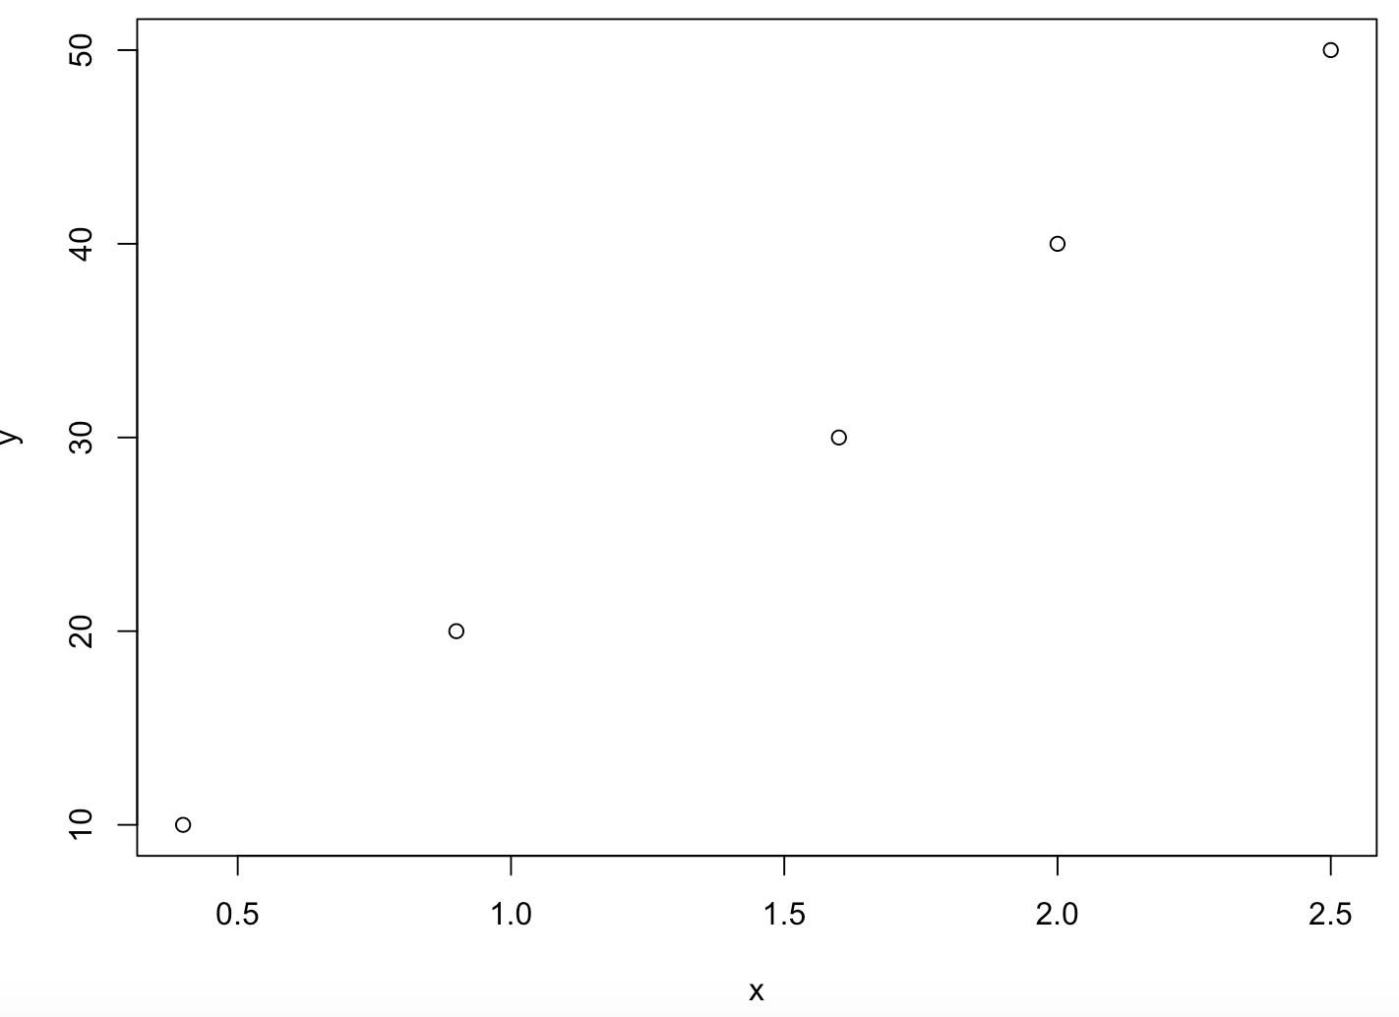
Creating your own S3 class
An instance of an S3 class can be created by simply adding a “class” attribute.
→ This makes the integrity of S3 objects rather fragile!
> x <- c(0.4, 0.9, 1.6, 2.0, 2.5)
> y <- c(10, 20, 30, 40, 50)
> df <- data.frame(x, y)
> class(df)
[1] "data.frame"
> attributes(df)
$names
[1] "x" "y"
$class
[1] "data.frame"
$row.names
[1] 1 2 3 4 5
> df
x y
1 0.4 10
2 0.9 20
3 1.6 30
4 2.0 40
5 2.5 50
> plot(df)

Slide 14
Creating your own S3 class
An instance of an S3 class can be created by simply adding a “class” attribute.
→ This makes the integrity of S3 objects rather fragile!
> x <- c(0.4, 0.9, 1.6, 2.0, 2.5)
> y <- c(10, 20, 30, 40, 50)
> df <- data.frame(x, y)
> class(df)
[1] "data.frame"
> attributes(df)
$names
[1] "x" "y"
$class
[1] "data.frame"
$row.names
[1] 1 2 3 4 5
> df
x y
1 0.4 10
2 0.9 20
3 1.6 30
4 2.0 40
5 2.5 50
> plot(df)
> attr(df, 'class') <- 'lm'
> class(df)
[1] ”lm"
> df
Call:
NULL
No coefficients
> plot(df)
Error in x$terms %||% attr(x, "terms") %||% stop("no terms component nor attribute") :
no terms component nor attribute

Slide 15
Creating your own S3 class
To avoid this in package development, one typically relies on “constructor” functions
growth <- function(ID, sex, age, len){
out <- list(
ID = ID,
sex = sex,
data = data.frame(age = age, len = len)
)
class(out) <- "growth"
return(out)
}

Slide 16
Creating your own S3 class
To avoid this in package development, one typically relies on “constructor” functions
growth <- function(ID, sex, age, len){
out <- list(
ID = ID,
sex = sex,
data = data.frame(age = age, len = len)
)
class(out) <- "growth"
return(out)
}
> alice <- growth(”Alice", ”Female", 0:10, (0:10)^2)
> class(alice)
[1] "growth"
> alice
$ID
[1] "Alice"
$sex
[1] "Female"
$data
age len
1 0 0
2 1 1
3 2 4
4 3 9
5 4 16
6 5 25
7 6 36
8 7 49
9 8 64
10 9 81
11 10 100
attr(,"class")
[1] "growth"

Slide 17
S4 classes to the rescue!
S4 works very similarly to S3 except it has formal definitions of classes. These definitions describe the class “fields” and structures.

Slide 18
S4 classes to the rescue!
S4 works very similarly to S3 except it has formal definitions of classes. These definitions describe the class “fields” and structures.
S4 objects fields are called “slots” (they are elements of a list-like object)

Slide 19
S4 classes to the rescue!
S4 works very similarly to S3 except it has formal definitions of classes. These definitions describe the class “fields” and structures.
S4 objects fields are called “slots” (they are elements of a list-like object)
S4 classes have strictly required properties:
Name. A class identifier, which should be UpperCamelCase (by convention).
Slots. A named list of names and permitted classes for slots. For instance with growth we might have list(ID=''character'', age=''numeric’’).
Contains. A string explicitly giving the classes it inherits from (i.e. contains).
Validity. A method that tests if an object is valid.
Prototype. A method that defines default slot values.

Slide 20
S4 classes to the rescue!
methods::new() is used to create a new object with an S4 class
setClass(
Class = "Person",
slots = list(
name = "character",
age = "numeric"
)
)
> alice <- new(
"Person",
name = "Alice",
age = 40
)
> alice
An object of class "Person"
Slot "name":
[1] "Alice"
Slot "age":
[1] 40

Slide 21
S4 classes to the rescue!
Here again, constructor function should be the #1 priority to write.
Generally, the constructor function bears the same name than the S4 class itself.
setClass(
Class = "Person",
slots = list(
name = "character",
age = "numeric"
)
)
Person <- function(name, age) {
methods::new(
"Person",
name = name,
age = age
)
}
> bob <- Person(
name = "Bob",
age = 32
)
> bob
An object of class "Person"
Slot "name":
[1] "Bob"
Slot "age":
[1] 32

Slide 22
S4 classes to the rescue!
The inflexibility of S4 classes reduces errors because the information is known, and valid.
Slots
Validity
Contains
setClass(
Class = "Person",
slots = list(
name = "character",
age = "numeric"
)
)
Person <- function(name, age) {
methods::new(
"Person",
name = name,
age = age
)
}
> matthew <- Person(
name = "Matthew",
age = 'twelve’
)
Error in validObject(.Object) :
invalid class “Person” object: invalid object for slot "age" in class "Person": got class "character", should be or extend class "numeric”
> henry <- Person(name = 'Henry', job = 'worker’)
Error in Person(name = "Henry", job = "worker") :
unused argument (job = "worker")

Slide 23
Some vocabulary
Class = blueprint, i.e. description of a data structure (attributes, methods)
Object = instance of a class

Slide 24
Some vocabulary
Class = blueprint, i.e. description of a data structure (attributes, methods)
Object = instance of a class
Method = function that only operates on certain classes

Slide 25
Some vocabulary
Class = blueprint, i.e. description of a data structure (attributes, methods)
Object = instance of a class
Method = function that only operates on certain classes
2 objects: 1 of class house and 1 of class canvas.
The “paint” method will not do the same thing for the 2 objects: it changes the color of the house or paints a painting on the canvas).

Slide 26
Some vocabulary
Class = blueprint, i.e. description of a data structure (attributes, methods)
Object = instance of a class
Method = function that only operates on certain classes
2 objects: 1 of class house and 1 of class canvas.
The “paint” method will not do the same thing for the 2 objects: it changes the color of the house or paints a painting on the canvas).
R is polymorphic: a given function, when applied to objects from different classes, returns a tailored result.

Slide 27
Examples
> x <- c(0.4, 0.9, 1.6, 2.0, 2.5)
> y <- c(10, 20, 30, 40, 50)
> L <- list(x = x, y = y)
> linmod <- lm(L)
> class(x)
[1] "numeric”
> class(y)
[1] "numeric”
> class(L)
[1] "data.frame”
> class(linmod)
[1] "lm"

Slide 28
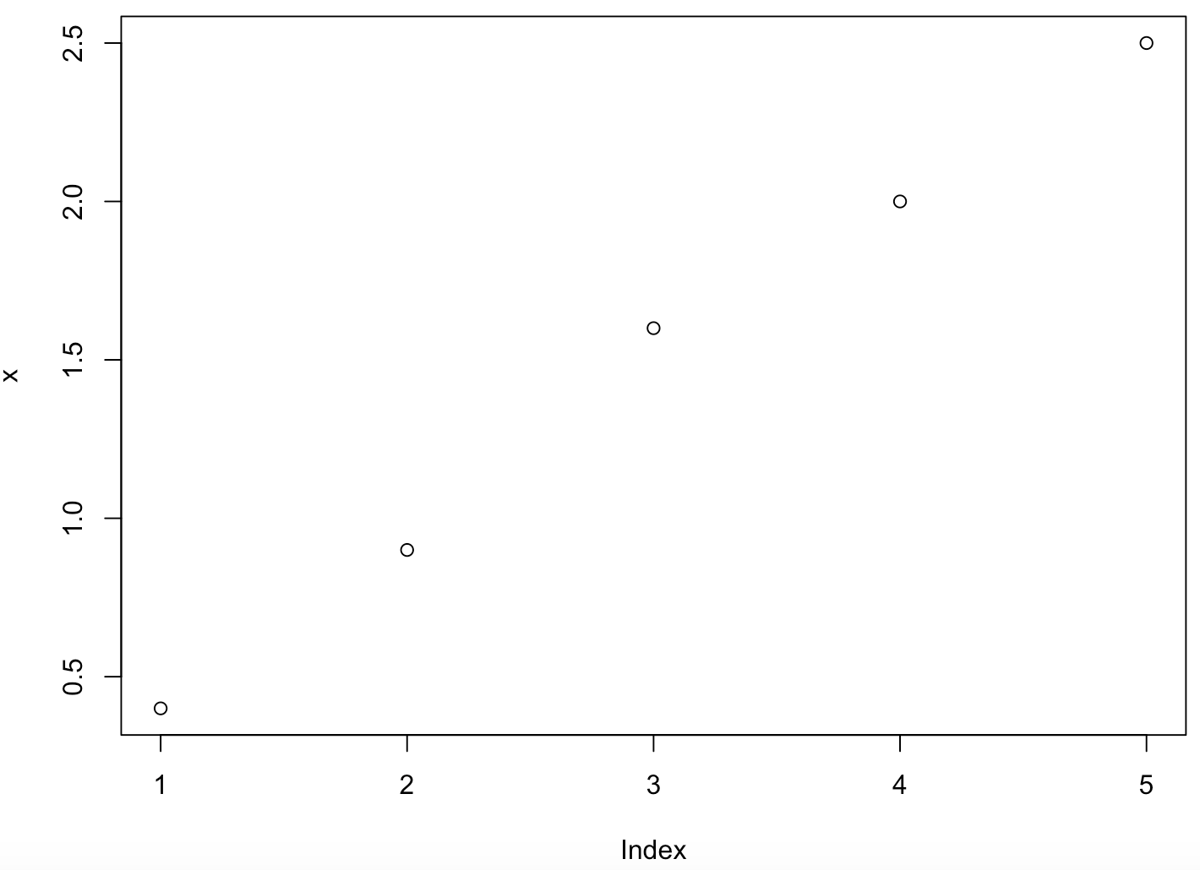
Examples
> x <- c(0.4, 0.9, 1.6, 2.0, 2.5)
> y <- c(10, 20, 30, 40, 50)
> L <- list(x = x, y = y)
> linmod <- lm(L)
plot(x)
plot(L)
> class(x)
[1] "numeric”
> class(y)
[1] "numeric”
> class(L)
[1] "data.frame”
> class(linmod)
[1] "lm"
plot(limod)

Slide 29
Creating S3 methods
In S3, the generic method detects the class type and dispatches (calls) arguments to the appropriate class-specific method.
Example:
plot is a generic function
plot.lm is a class-specific (lm) function

Slide 30
Creating S3 methods
If the generic function does not exist, one need to create it:
myfun <- function(x) UseMethod(”myfun”)
In this case, a default method should also be created!
myfun.default <- function(x) “default method for `myfun`”
The class-specific method created by a developed is named <generic>.<class> (e.g. plot.lm):
myfun.myclass <- function(x) {…}

Slide 31
Creating S3 methods
#Class constructor
growth <- function(ID, sex, age, len){
out <- list(
ID = ID,
sex = sex,
data = data.frame(age = age, len = len)
)
class(out) <- "growth"
return(out)
}
#1. Generic function
growthPlot <- function(x)
UseMethod("growthPlot")
#2. Default method
growthPlot.default <- function(x)
"Unknown class"
#3. Class-specific method
growthPlot.growth <- function(object){
d <- object$data
plot(
d$age, d$len, type="b", xlab="Age", ylab="Length (cm)",
main=paste("Growth for", object$ID)
)
}
> alice <- growth(”Alice", ”Female", 0:10, (0:10)^2)
> growthPlot(alice)

Slide 32
Creating S4 methods
S4 methods behave very similarly to S3 methods. How methods are initiated is slightly different.
Just like for S3 methods, a generic method is required for any function. If it does not already exist (though it is likely!), one need to set it, with setGeneric (instead of <generic> in S3).
There is no need to set a default method! The generic will be used if no matching class-specific method is found.
The setMethod function is used to create a method for a specific class (instead of <generic>.<class> in S3).

Slide 33
Creating S4 methods
setClass(
Class = "Person",
slots = list(
name = "character",
age = "numeric"
)
)
Person <- function(name, age) {
methods::new(
"Person",
name = name,
age = age
)
}
#1. Generic method
setGeneric("age", function(object)
"Unknown class")
#2. Class-specific method
setMethod(
function = "age",
signature="Person",
definition = function(object){
cat(object@name, "is a person of age", object@age, "\n")
}
)
> bob <- Person(
name = "Bob",
age = 32
)
> bob
An object of class "Person"
Slot "name":
[1] "Bob"
Slot "age":
[1] 32
> age(bob)
Bob is a person of age 32

Slide 34
Fundamental concepts of R classes
Constructor: A function which generates objects of a S3/S4 class.
Polymorphism: Same function call leads to different operations for objects of different classes.
Generic Function: A function which behaves differently depending on the class of the argument.
Dispatch: The process of determining the correct method to call based on the argument type

Slide 35
Further reading on S4 classes & methods
https://bioconductor.org/help/course-materials/2017/Zurich/S4-classes-and-methods.html

